Slide 1

DEPARTMENT OF ARTIFICIAL INTELLIGENCE AND DATA SCIENCE ACADEMIC YEAR 2025 - 2026 SEMESTER III ARTIFICIAL INTELLIGENCE LABORATORY MINI PROJECT REVIEW <MAZE ESCAPE GAME USING BFS >
REGISTER NUMBER | 2117240070061
NAME | DHARISANA R
YEAR | ||
SECTION | A
FACULTY IN-CHARGE | Mrs. M. Divya

Slide 2
PROBLEM STATEMENT
Brief Overview: Artificial Intelligence (AI) enables systems to make intelligent decisions; in this Maze Escape Game, AI uses the Breadth-First Search (BFS) algorithm to find the shortest path from start to goal efficiently.
Problem Statement: Design an AI-based maze game where BFS systematically explores all possible paths to locate the shortest route between the start and exit points.
Expected Result: The AI successfully finds and displays the shortest escape path; the model can be extended using A*, Dijkstra, or heuristic-based methods for complex mazes.

Slide 3
THEORETICAL BACKGROUND
Theoretical Background: BFS is an uninformed search algorithm that explores nodes level by level, ensuring completeness and optimality in unweighted mazes.
Literature Survey: Compared to DFS, Dijkstra, and A*, BFS provides the simplest and most reliable solution for equal-cost maze problems, making it ideal for game-based AI pathfinding.
Justification: BFS guarantees the shortest path, is easy to implement, and performs efficiently for small to medium mazes.
Algorithm Explanation: BFS uses a queue to explore neighboring cells systematically; once the goal is found, it traces back the parent nodes to reconstruct the optimal path.

Slide 4
IMPLEMENTATION AND CODE
Link to code in Git-hub Repository
List | Git-hub Repository Links
Implementation of Code Link | https://github.com/dharisana24-bot/maze-escape-game/blob/b914bb309426da270816781aaf82507334e013f0/maze.py
Word Document Report Link | Maze_Escape_Game_BFS_Report.docx
PPT Link | AILAB_MINI_PPT_TEMPLATE_AI^0DS.pptx

Slide 5
CODE
# Maze Escape Game using BFS with Visualization
import matplotlib.pyplot as plt
import matplotlib.animation as animation
from collections import deque
# Define the BFS function
def bfs_with_visualization(maze, start, goal):
rows, cols = len(maze), len(maze[0])
visited = [[False]*cols for _ in range(rows)]
parent = {}
queue = deque([start])
visited[start[0]][start[1]] = True
directions = [(-1,0), (1,0), (0,-1), (0,1)]
frames = [] # store exploration steps for animation
while queue:
current = queue.popleft()
frames.append([row[:] for row in visited]) # snapshot
if current == goal:
break
for d in directions:
new_row, new_col = current[0] + d[0], current[1] + d[1]
if (0 <= new_row < rows and 0 <= new_col < cols and

Slide 6
CODE
maze[new_row][new_col] == 0 and not visited[new_row][new_col]):
queue.append((new_row, new_col))
visited[new_row][new_col] = True
parent[(new_row, new_col)] = current
# Reconstruct shortest path
path = []
node = goal
while node != start:
path.append(node)
node = parent.get(node)
if node is None:
print("No path found!")
return frames, []
path.append(start)
path.reverse()
return frames, path
# Draw the maze and animate BFS exploration
def visualize_bfs(maze, frames, path):
fig, ax = plt.subplots()
maze_display = [[1 if cell == 1 else 0 for cell in row] for row in maze]
img = ax.imshow(maze_display, cmap='gray')
def update(frame):
display = [[1 if cell == 1 else 0 for cell in row] for row in maze]
for r in range(len(frame)):

Slide 7
CODE
def update(frame):
display = [[1 if cell == 1 else 0 for cell in row] for row in maze]
for r in range(len(frame)):
for c in range(len(frame[0])):
if frame[r][c]:
display[r][c] = 0.6 # explored area
img.set_data(display)
return [img]
ani = animation.FuncAnimation(fig, update, frames=frames, repeat=False, interval=200)
plt.title("BFS Maze Exploration")
plt.show()
# Show final path
for r, c in path:
maze_display[r][c] = 0.3
plt.imshow(maze_display, cmap='gray')
plt.title("Shortest Path Found by BFS")
plt.show()
# Example Maze (0 = path, 1 = wall)
maze = [
[0, 0, 1, 0, 0],
[0, 0, 1, 0, 1],
[1, 0, 0, 0, 0],
[0, 1, 0, 1, 0],
[0, 0, 0, 1, 0]
start = (0, 0)
goal = (4, 4)
# Run BFS and visualize
frames, path = bfs_with_visualization(maze, start, goal)
print("Shortest Path:", path)
visualize_bfs(maze, frames, path)

Slide 8
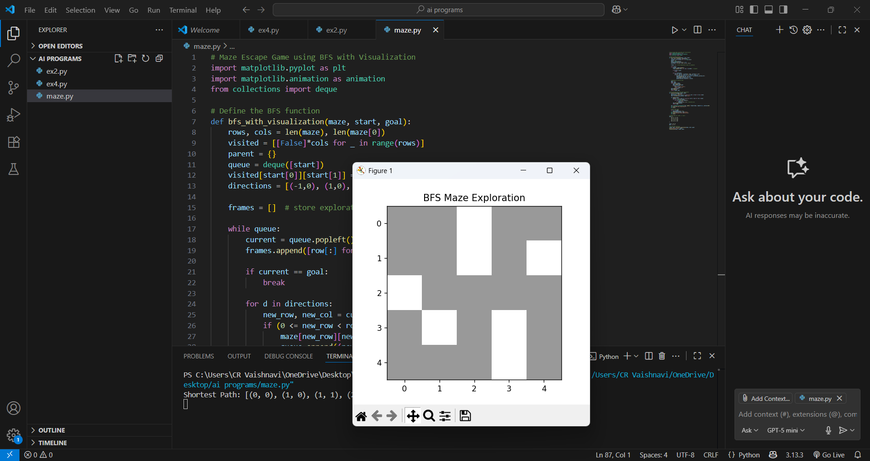
OUTPUT AND RESULTS

Slide 9
REFERENCES
“Optimization of Breadth-First Search Algorithm for Path Solutions in Maze Games”
— Bonifacius Vicky Indriyono & Widyatmoko.
Link: https://www.researchgate.net/publication/362385104_Optimization_of_Breadth-First_Search_Algorithm_for_Path_Solutions_in_Mazyin_Games ResearchGate
“A Comparative Study of DFS, BFS, and A* Search Algorithms” — Badr Elkari et al., 2024.
Link: https://www.iapress.org/index.php/soic/article/view/1939 iapress.org
“Introduction to Pathfinding with Mazes and Breadth-first Search”
— Tom Cant (blog post).
Link: https://tomcant.dev/posts/2021/09/introduction-to-pathfinding-with-mazes-and-breadth-first-search/ tomcant.dev
“Solve Maze using Breadth-First Search (BFS) Algorithm” —
Luthfis Auqi (Medium article).
Link: https://medium.com/%40luthfisauqi17_68455/artificial-intelligence-search-problem-solve-maze-using-breadth-first-search-bfs-algorithm-255139c6e1a3 Medium
“Pathfinding in Strategy Games and Maze Solving Using A*” — SCIRP article
Link: https://www.scirp.org/journal/paperinformation?paperid=70460 scirp.org

